Slide 1

E-cigarettes

Slide 2
Contents
Topic | Slide No
What’s an E-cigarette | 3
Basic structure | 4
Functioning of E-cigarette | 5
One E-cigarette, many names | 6
What’s E-cigarette aerosol | 7
History | 8
Ill-effects | 9-11
Indian context | 12

Slide 3
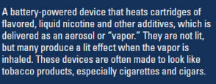
What’s an E-cigarette?

Slide 4
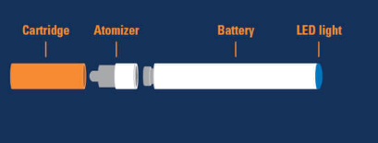
Basic structure

Slide 5

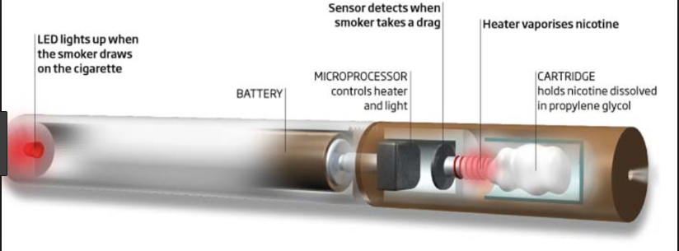
Functioning of E-cigarette

Slide 6
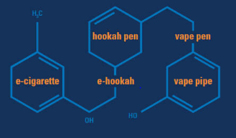
One E-cigarette, many names

Slide 7

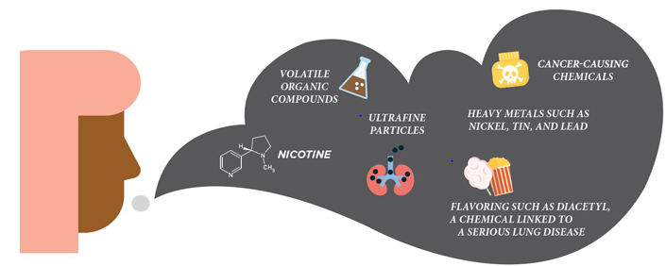
What’s E-cigarette Aerosol ?

Slide 8


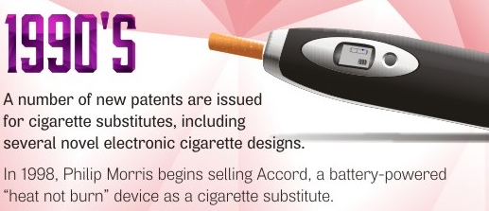



History

Slide 9
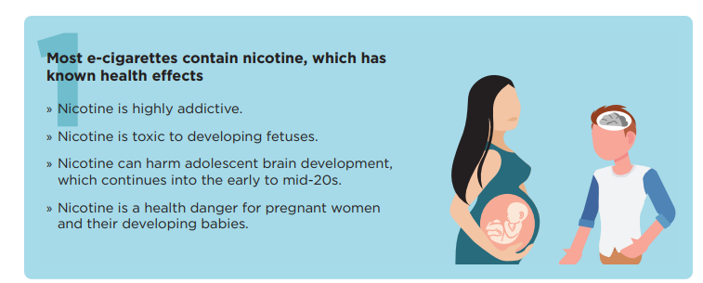
Ill effects

Slide 10

Ill effects

Slide 11
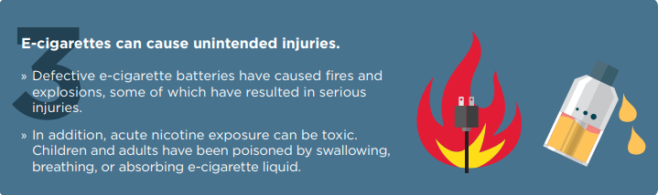
Ill effects

Slide 12
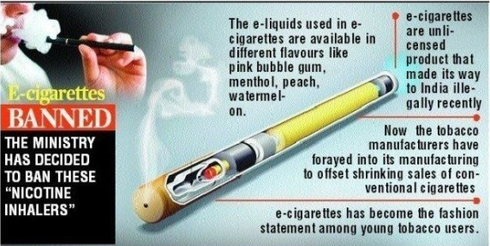
Indian context

Slide 13
Thank You

