Slide 1

Ill-effects of tobacco

Slide 2
Tobacco & Origin
Nicotine Addiction
Cigarette-A storehouse of chemicals
Smoking Health Risks

Slide 3
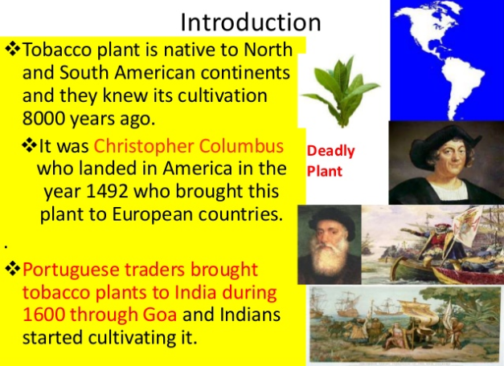
Tobacco & Origin

Slide 4
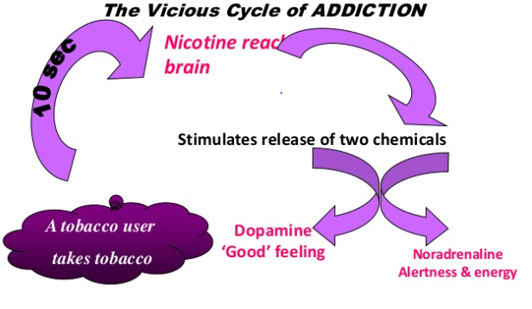
Nicotine Addiction

Slide 5
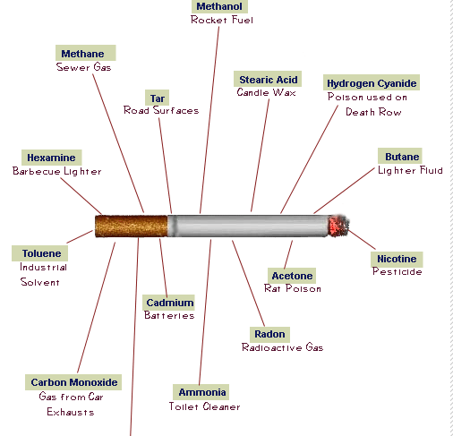
Cigarette-A storehouse of chemicals

Slide 6
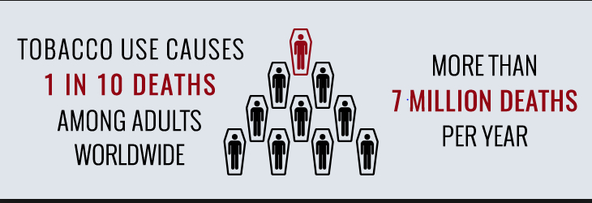
Tobacco & Mortality

Slide 7
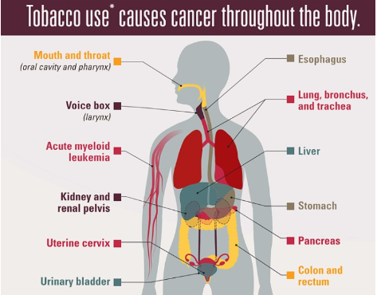
Tobacco & Health

Slide 8
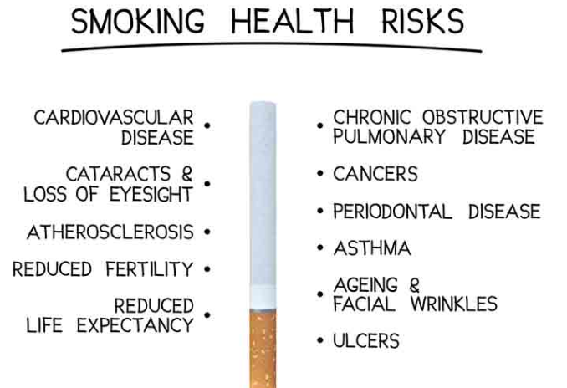
Smoking & Health

Slide 9
Thank You

