Slide 1

Tobacco Industry Interference

Slide 2
Topic
FCTC-What is it?
The Basics about FCTC
What FCTC Intends?
The Guiding Principles of FCTC
Tobacco Advertising
Why it is important…
Areas of Focus…
A Climb Down In Some Ways
A Practical way of controlling tobacco
Benefits of licensing tobacco shops

Slide 3
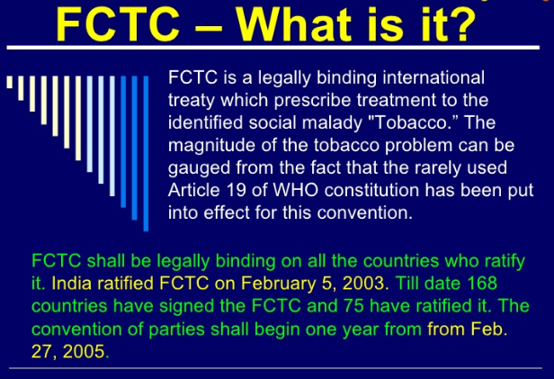

Slide 4
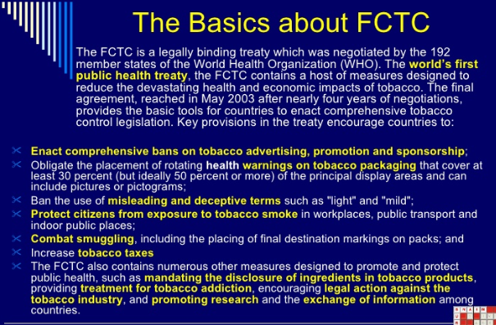

Slide 5
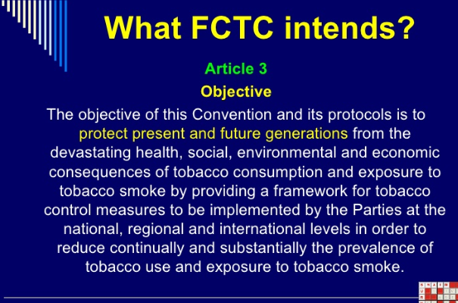

Slide 6
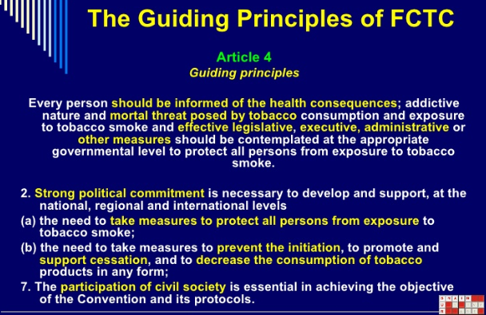

Slide 7
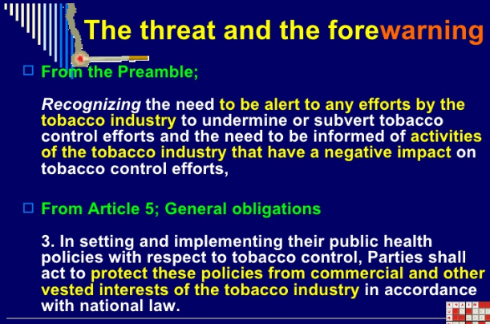

Slide 8
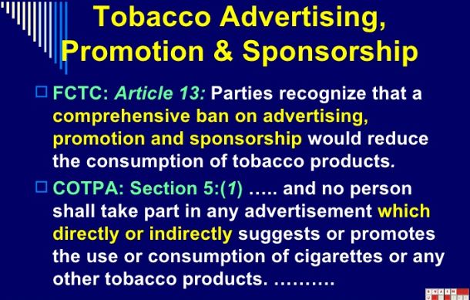

Slide 9
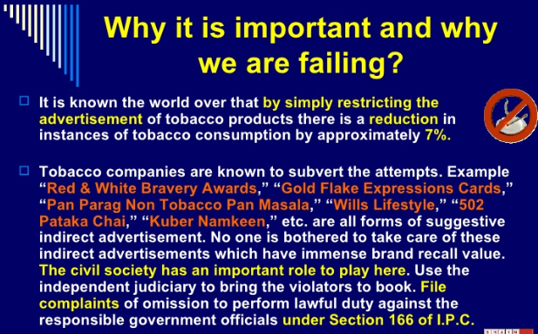

Slide 10
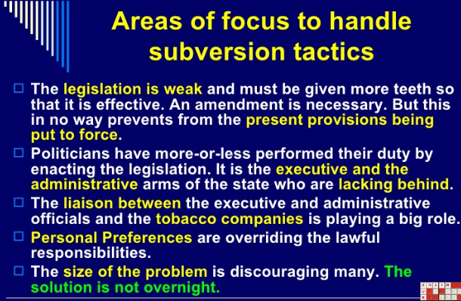

Slide 11
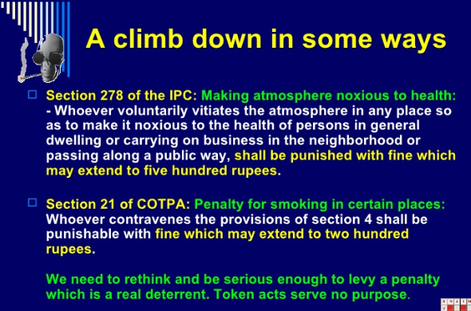

Slide 13
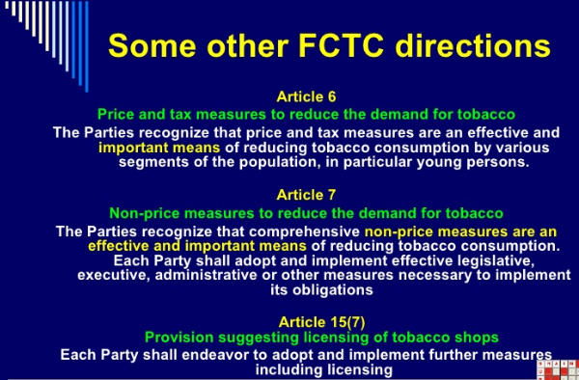

Slide 14
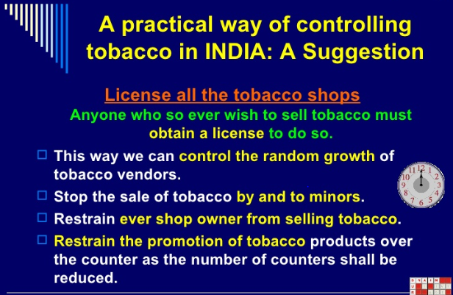

Slide 15
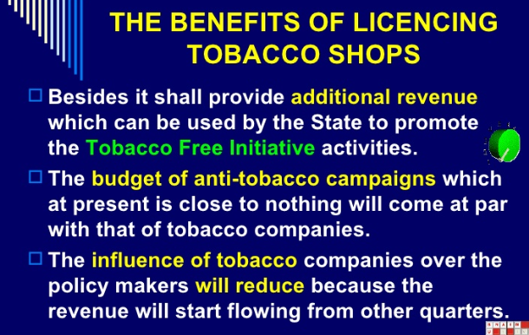

Slide 16
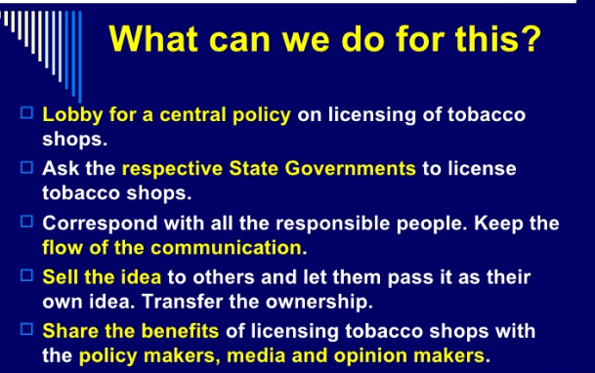

Slide 17
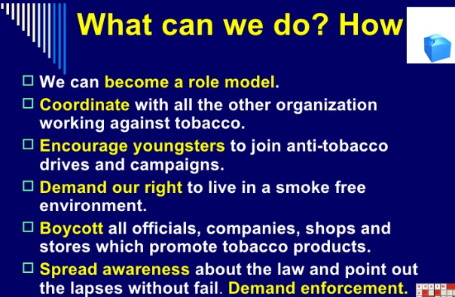

Slide 18
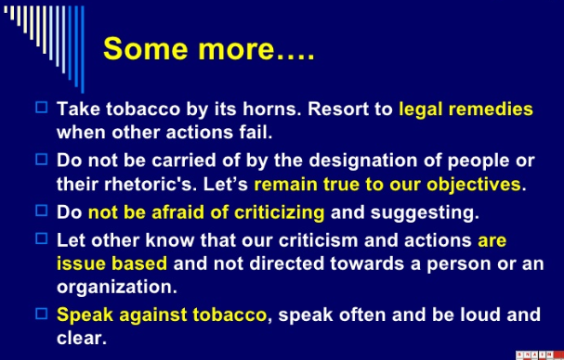

Slide 19
Thank You

