Slide 1
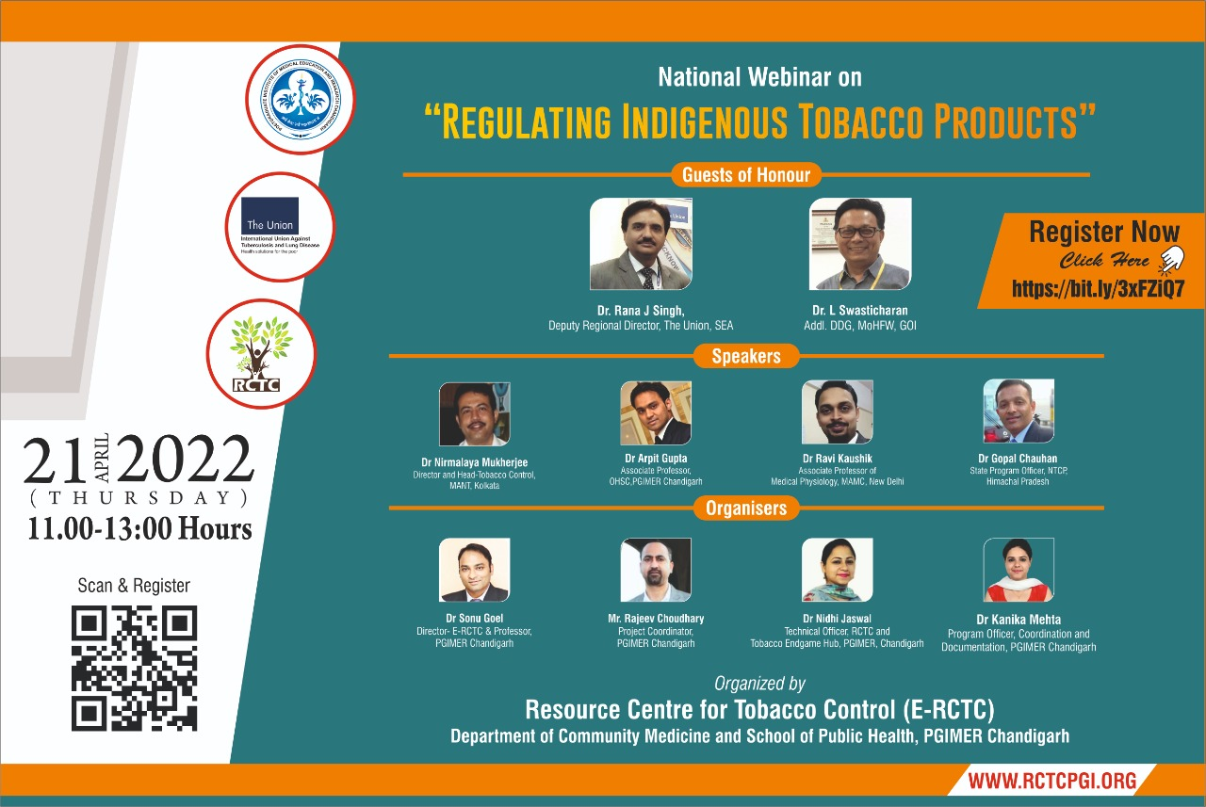

Slide 2
AGENDA OF THE WEBINAR
Time | Session | Facilitator
11.00 – 11. 10 am | Welcome address | Dr. Sonu Goel
11.10 – 11.20 am | Address by Guest of Honours | Dr. Rana J Singh Dr. L Swasticharan
11.20 – 11.35am | Introduction to Indigenous Tobacco Products and its Distribution in India | Dr. Nirmalaya Mukherjee
11.35 – 11:50 AM | Pattern of Usage of Indigenous Tobacco Products | Dr. Ravi Kaushik
11:50 – 12.05 pm | Do indigenous tobacco products causes additional harms? | Dr Arpit Gupta
12.05 – 12.20 pm | Challenges and recommendations to address indigenous tobacco products in India | Dr. Gopal Chauhan
12:20-12:35 PM | Various government initiatives for regulation or elimination of indigenous tobacco products | Dr. L Swasticharan
12.35 - 1.00 pm | Finalization of Recommendations | All Experts
1:00 pm | Vote of Thanks | Mr. Rajeev Kumar

Slide 3

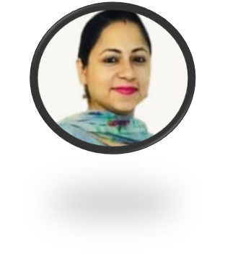
HOST OF THE WEBINAR
Dr. Nidhi Jaswal
Technical Officer (RCTC and Tobacco Endgame Hub),
DCM& SPH, PGIMER Chandigarh
Doctorate in Psychology with specialization in Geriatric Health-2013
Over 15 years of experience of working in the field of Health Promotion and Disease Prevention in PGIMER, Chandigarh.
Published over 40 peer reviewed papers, book chapters, and reports.
She has also authored a book on ‘Psycho-social dimensions of ageing in India’.
Certified Master Trainer for Adolescent Health by Ministry of Health and Family Welfare, New Delhi and certified qualitative research analyst.
Trained in conducting laughter yoga classes and stress management workshops.

Slide 4
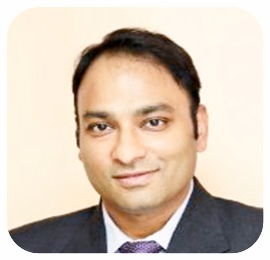
Welcome Address by Dr. Sonu Goel
Dr. Sonu Goel
Professor, PGIMER Chandigarh
Director RCTC Chandigarh and Professor in Dept. of Community Medicine & School of Public Health PGIMER Chandigarh.
18 years of experience in the field of Public Health.
Recipient of various awards including Young researcher award by IAPSM-FORD Foundation, Harcharan Singh Oration Award, Vasudeva Oration Award and many more to his credit.
Vice-Chair of Tobacco Control Section and leading MPOWER Research Group of The Union.
Adjunct Associate Clinical Professor in the School of Medicine, Faculty of Education & Health Sciences, University of Limerick, Ireland.
Honorary Professor in the Faculty of Human & Health Sciences at Swansea University, United Kingdom.

Slide 5
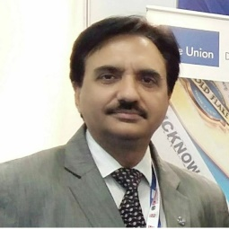
Address by Guest of Honor
Dr Rana J Singh:
Deputy Regional Director,
The Union, SEA
Deputy Regional Director in International Union Against Tuberculosis & Lung Disease New Delhi, India.
Medical doctor with MD in pulmonary medicine.
25+ years of experience in public health focusing on management and tobacco control.
Master trainer of courses for mid and senior level managers.
Currently supporting tobacco and NCD control programmes in South-East Asia Region.

Slide 6
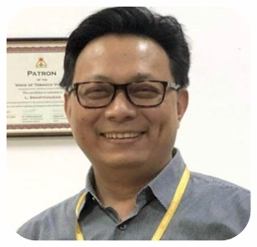
Address by Guest of Honor
Dr. L Swasticharan
Addl DDG, MoHFW, GOI
Currently leads three national level Non-Communicable Disease programmes in the Directorate General of Health Services, Ministry of Health, Government of India.
Obtained his medical degree in Community Health Administration from Delhi University, Delhi, India, and his Master’s in Public Health (MPH) from Massey University, New Zealand. His main interest is in Operational Research.
In the PH-LEADER programme he expects to learn about prioritizing public health issues based on evidence and best practices from across the world and to try to adapt and implement them in the National Programmes for management of NCDs in India.

Slide 7
TECHNICAL SESSIONS

Slide 8
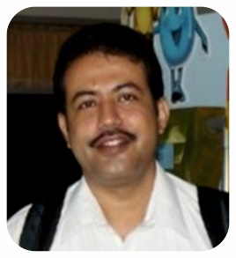
Topic: Introduction to Indigenous Tobacco Products and its Distribution in India
Dr. Nirmalya Mukherjee
Director and Head (Tobacco Control), MANT, Kolkata
Did his masters in social work from Vidyasagar University and MPH from Mahidol University, Bangkok.
Completed his PhD in 2019 and attended short/executive courses at Johns Hopkins University and University of Pennsylvania.
Experienced Director with a demonstrated history of working in the non-profit organization management industry. Skilled in Tobacco Control, ICT4D, Program Evaluation, Reproductive Health, Behavior Change, and Health Promotion.

Slide 9
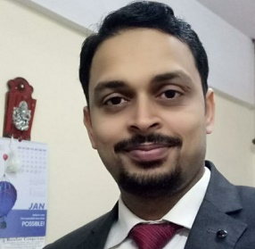
Topic: Pattern of Usage of Indigenous Tobacco Products
Dr. Ravi Kaushik
Associate Professor of Medical Physiology, MAMC
MD from Delhi University and a certificate in management from Wharton Business School.
His areas of interest are Oncology, tobacco control, and epidemiology and handled numerous clinical trials in India, Africa and USA. Currently handling four studies of a global project “ASTRA – Addressing Smokeless Tobacco and Building Research Capacity in South Asia”
Worked with ICMR-National Institute of Cancer Prevention and Research (NICPR) and ‘WHO-FCTC Global Knowledge Hub on Smokeless Tobacco’ as Scientist and was Nodal officer, National Tobacco Testing Laboratory.
Involved in various governmental programs like the “National Drug control & De-addiction Task Force” and ICMR-task force study on smokeless tobacco and reproductive health.

Slide 10
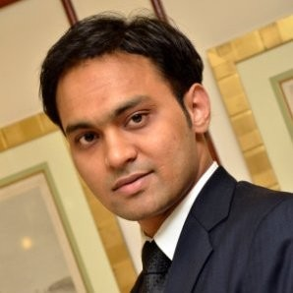
Topic: Do indigenous tobacco products causes additional harms?
Dr. Arpit Gupta
Associate Professor, Oral Health Science Centre, PGIMER, Chandigarh
Working as Associate professor in Oral Health Science Centre, PGI Chandigarh.
Worked as a Research Officer in All India Institute of Medical Sciences, New Delhi for National Oral Health Program, Ministry of Health & Family Welfare, Government of India.
Did his Senior Residency from 2013 to 2016 in Centre for Dental Education and Research, All India Institute of Medical Sciences, New Delhi

Slide 11
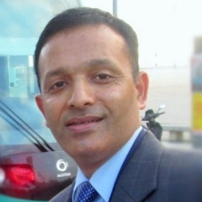
Topic: Challenges and recommendations to address indigenous tobacco products in India
Dr. Gopal Chauhan
SPO, NTCP, Govt. of Himachal Pradesh
State Program Officer for NCDs prevention and control in Himachal Pradesh focusing on integrated approach and digital surveillance of all common NCDs.
Masters of Public Health from Postgraduate Institute of Medical Education and Research.
Worked as a Medical Officer in one of the remotest Primary Health Centre in the State of Himachal Pradesh in 2002.
State Nodal Officer for Tobacco Control School Health Programs in 2007.
District Program Officer from 2013 to 2014 for preventing female foeticide.

Slide 12

Topic: Various Government Initiatives for regulation/elimination of indigenous tobacco products
Dr. L Swasticharan
Addl DDG, MoHFW, GOI
Dr. Leimapokpam Swasticharan currently leads three national level Non-Communicable Disease programmes in the Directorate General of Health Services, Ministry of Health, Government of India.
Obtained his medical degree in Community Health Administration from Delhi University, Delhi, India, and Master’s in Public Health (MPH) from Massey University, New Zealand. His main interest is in Operational Research.
He also attended the PH-LEADER programme.

Slide 13
FINALIZATION OF RECOMMENDATIONS

Slide 14
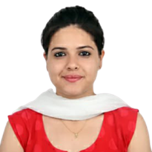
Vote of Thanks
Dr. Kanika Mehta
Program Officer, Coordination and Documentation, PGIMER Chandigarh
Dr. Kanika Mehta is working as a Program officer (Coordination and Documentation) in the BI (UNION) Project.
Master in Public Health from Panjab University, Chandigarh.
Provides technical assistance for development, monitoring and evaluation of Tobacco Free Times(Bi-monthly Publication).
She also contributes for writing reports, social media stories, live feeds on various social media platforms (twitter, facebook and youtube).
She has a clinical experience as a Ayurvedic Practitioner.

Slide 15

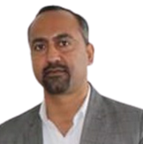
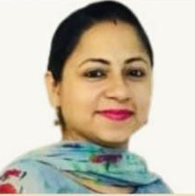
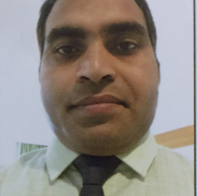

Project team
Mr. Rajeev Chaudhary
Project Coordinator
PGIMER Chandigarh
Dr. Nidhi Jaswal
Technical Officer
RCTC and Tobacco Endgame-Hub, PGIMER Chandigarh
Dr. Kanika
Program Officer
Coordination and Documentation, PGIMER Chandigarh
Mr. Neeraj
Admin cum Finance Assistant, PGIMER Chandigarh

