Slide 1


Slide 2
AGENDA OF THE WEBINAR
Time | Session | Facilitator
11.00 – 11. 10 am | Welcome address and objectives | Dr. Sonu Goel
11.10 – 11.30 am | Address by Guests of Honour Address by Chief Guest | Dr Rana J Singh Dr K S Sachdeva Dr L Swasticharan
11.30 – 11.45 am | Plain packaging: Concept, Importance and potential impact | Dr. Amit Yadav
11.45 – 12.00 am | Global experience of Plain Packaging -Challenges to Implementation | Dr RakeshMahajan
12.15 – 12.30 pm | Plain Packaging adoption and implementation in India – Research and Recommendations | Dr. Deepika Bahl
12.30 – 12.50 pm | Finalization of Recommendations | By All Experts
12.50 – 1.00 pm | Vote of Thanks | Mr. Rajeev

Slide 3

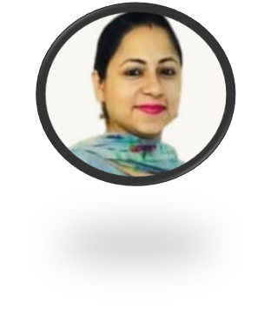
HOST OF THE WEBINAR
Dr. Nidhi Jaswal
Technical Officer (RCTC and Tobacco Endgame Hub),
DCM& SPH, PGIMER Chandigarh
Doctorate in Psychology with specialization in Geriatric Health-2013
Over 15 years of experience of working in the field of Health Promotion and Disease Prevention in PGIMER, Chandigarh.
Published over 40 peer reviewed papers, book chapters, and reports.
She has also authored a book on ‘Psycho-social dimensions of ageing in India’.
Certified Master Trainer for Adolescent Health by Ministry of Health and Family Welfare, New Delhi and certified qualitative research analyst.
Trained in conducting laughter yoga classes and stress management workshops.

Slide 4
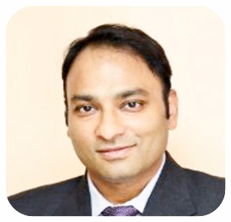
Welcome Address and objectives of the webinar
Dr. Sonu Goel
Professor, PGIMER Chandigarh
Director RCTC Chandigarh and Professor in Dept. of Community Medicine & School of Public Health PGIMER Chandigarh.
18 years of experience in the field of Public Health.
Recipient of various awards including Young researcher award by IAPSM-FORD Foundation, Harcharan Singh Oration Award, Vasudeva Oration Award and many more to his credit.
Vice-Chair of Tobacco Control Section and leading MPOWER Research Group of The Union.
Adjunct Associate Clinical Professor in the School of Medicine, Faculty of Education & Health Sciences, University of Limerick, Ireland.
Honorary Professor in the Faculty of Human & Health Sciences at Swansea University, United Kingdom.

Slide 5
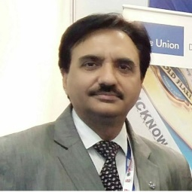
Address by Guest of Honour
Dr Rana J Singh:
Deputy Regional Director,
The Union, SEA
Deputy Regional Director in International Union Against Tuberculosis & Lung Disease New Delhi, India.
Medical doctor with MD in pulmonary medicine.
25+ years of experience in public health focusing on management and tobacco control.
Master trainer of courses for mid and senior level managers.
Currently supporting tobacco and NCD control programmes in South-East Asia Region.

Slide 6
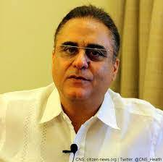
Address by Guest of Honour
Dr Kuldeep S Sachdeva,
Country Director,
The Union- SEA
Dr Kuldeep Singh Sachdeva is a medical doctor (MBBS) with over 32 years’ professional experience within the Indian government health system.
He has served as Deputy Director General in Ministry of Health and Family Welfare, GOI.
He provides leadership and management to all Union programme activities of the SEA regional office.
He has played an important role in strengthening health systems, promoting Public-Private Mix in tuberculosis (TB) Control, supporting TB collaborative activities with HIV, Tobacco, Diabetes, Paediatric TB, and the scaling up of programmatic management of drug resistant TB.

Slide 7
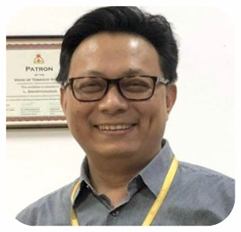
Address by the Chief Guest
Dr. L Swasticharan
Addl DDG, MoHFW, GOI
Currently leads three national level Non-Communicable Disease programmes in the Directorate General of Health Services, Ministry of Health, Government of India.
Obtained his medical degree in Community Health Administration from Delhi University, Delhi, India, and his Master’s in Public Health (MPH) from Massey University, New Zealand. His main interest is in Operational Research.
In the PH-LEADER programme he expects to learn about prioritizing public health issues based on evidence and best practices from across the world and to try to adapt and implement them in the National Programmes for management of NCDs in India.

Slide 8
TECHNICAL
SESSIONS

Slide 9

Topic: Plain Packaging: Concept, Importance and Potential Impact
Dr. Amit Yadav
Senior Technical Advisor, International Union Against Tuberculosis and Lung Diseases
He worked as a Post- doctoral Scholar at the Centre for Tobacco Control Research and Education, University of California, San Francisco, USA.
He has worked with HRIDAY, PHFI, WHO, ICMR-NICPR, WHO-FCTC Global Knowledge hub on SLT.
He was also an elected member of the Board of Directors of the Framework Convention Alliance representing SEARO for 2016 – 2019.
Worked in the field of public health law, policy and research and published several peer reviewed papers, book chapters, reports and monograph on tobacco control.
He has also authored a book on ‘Public Health Tobacco and Trade in India”.

Slide 10
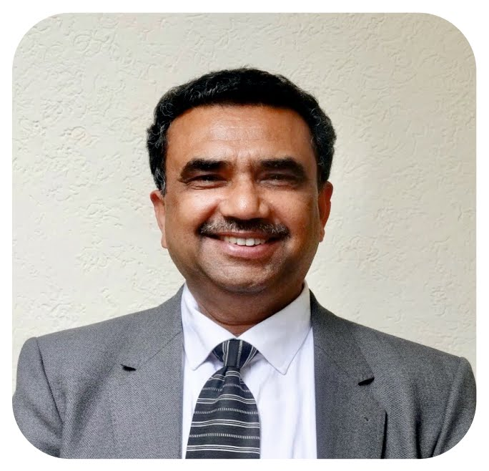
Topic: Global experience of Plain Packaging -Challenges to Implementation
Dr. Rakesh Gupta
President and Director of Public Health,
Strategic Institute for Public Health Education and Research
Professional experience of about 36 years in Punjab Government as a PCMS Officer.
More than 10 years of expertise in managing and actively contributing to National Non-Communicable diseases Programmes especially Blindness Control/ Tobacco Control Programmes.
Alumni of John Hopkins School of Public Health, Baltimore-2012 and University of California San Francisco-2012 as a short term scholar.
Former Director of Health Services and Chief Chemical Examiner, Dept. of Home Affairs and Justice, Punjab.

Slide 11
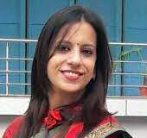
Topic: Plain Packaging adoption and implementation in India – Research and Recommendations
Dr. Deepika Bahl
Research Consultant
Public Health Foundation of India,
New Delhi
Dr. Deepika Bahl is a public health researcher, with an interest in research, health promotion and health advocacy.
She has an experience of 8 years in designing, implementing, managing researches on various health issues.
She has published scientific papers in peer-reviewed journals and has presented her work in international conferences.
She is also managing e-Course on Tobacco Control since 2018 at Health Promotion Division, Public Health Foundation of India.

Slide 12
FINALIZATION OF RECOMMENDATIONS

Slide 13
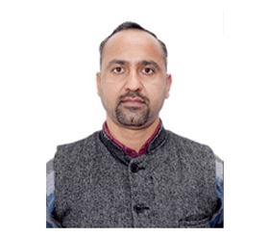
Vote of Thanks
Mr. Rajeev Chaudhary
Project Coordinator,
PGIMER Chandigarh
Over 12 years of experience in health sector, he has been involved in implementation of different projects at various levels.
Global leadership certification for Tobacco Control & Climate Reality.
Assistant editor of bi- monthly newsletter named “Tobacco Free Times” by Resource Centre for Tobacco Control under Department of Community Medicine & School of Public Health, PGIMER Chandigarh.
Alumni of John Hopkins University

Slide 14

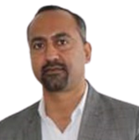
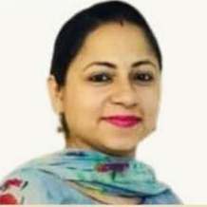
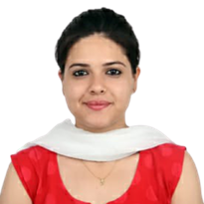
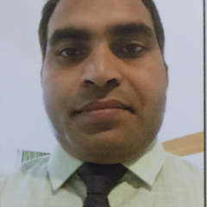

Project team
Dr. Nidhi Jaswal
Technical Officer
RCTC and Tobacco Endgame-Hub, PGIMER Chandigarh
Dr. Kanika
Program Officer
Coordination and Documentation, PGIMER Chandigarh
Mr. Neeraj
Admin cum Finance Assistant, PGIMER Chandigarh
Mr. Rajeev Chaudhary
Project Coordinator
PGIMER Chandigarh

