Slide 1

NATIONAL CONSULTATION
OF COALITION OF EXPERTS FOR FRAMEWORK DEVELOPMENT
OF TOBACCO ENDGAME HUB IN INDIA
INTRODUCTION TO TOBACCO ENDGAME HUB
TED^{H}

Slide 2
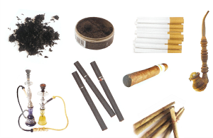
NATIONAL CONSULTATION
OF COALITION OF EXPERTS FOR FRAMEWORK DEVELOPMENT
OF TOBACCO ENDGAME HUB IN INDIA
Prevalence of Tobacco Use in India
267 million tobacco smokers
The Global Adult Tobacco Survey-2 (2016-17)
1. Overall prevalence of tobacco-28.6%
smoked:10.38%,
smokeless tobacco use (SLT): 21.38%
2. Total economic costs attributed to tobacco use in India (2017-18)- USD 27.5 billion
World's second largest consumer of tobacco products.

Slide 3
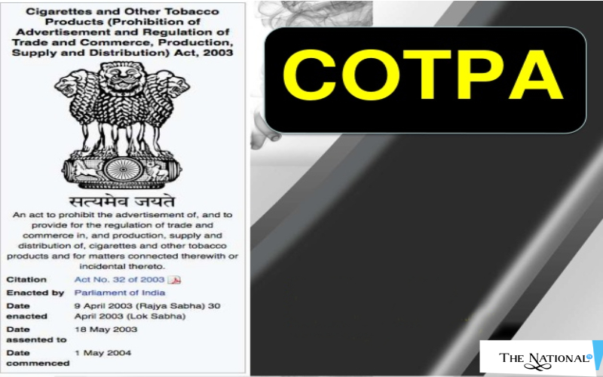
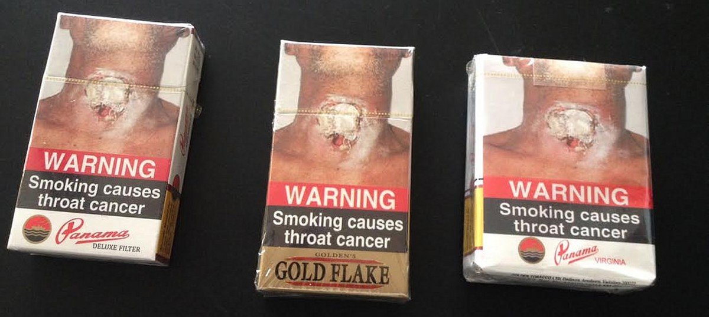
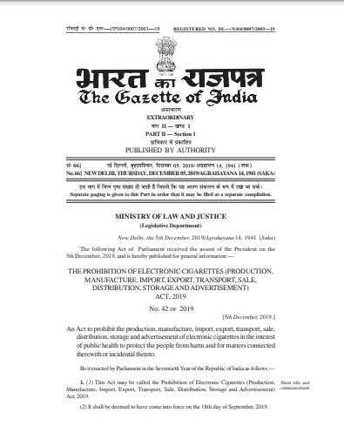


NATIONAL CONSULTATION
OF COALITION OF EXPERTS FOR FRAMEWORK DEVELOPMENT
OF TOBACCO ENDGAME HUB IN INDIA
Key Achievements of Tobacco Control in India
2003
85% pictorial health warnings
2008
National Tobacco Quitline Number
PECA, 2019

Slide 4
NATIONAL CONSULTATION
OF COALITION OF EXPERTS FOR FRAMEWORK DEVELOPMENT
OF TOBACCO ENDGAME HUB IN INDIA
Why Tobacco ENDGAME ?
Wean out tobacco use in a phased manner
Reduce tobacco induced diseases and related costs
Restrict new users from entering addiction

Slide 5
NATIONAL CONSULTATION
OF COALITION OF EXPERTS FOR FRAMEWORK DEVELOPMENT
OF TOBACCO ENDGAME HUB IN INDIA
TOBACCO ENDGAME Defined
The tobacco ‘endgame’ encapsulates both a process and a goal. In the context of health and tobacco, the endgame is: ‘the final stage of the process of ending tobacco use’.
Initiatives designed to permanently change the structural, political, and social dynamics that sustain the commercial tobacco epidemic, in order to end it.
SOURCES:
Thomson G, Edwards R, Wilson N, Blakely T. What are the elements of the tobacco endgame? Tobacco Control 2012;21:293e295. doi:10.1136/tc.2010.040881
Malone, R. E., McDaniel, P. A., Smith, E. A. (2014). Tobacco Control Endgames: Global Initiatives and Implications for the UK. Cancer Research UK

Slide 6
NATIONAL CONSULTATION
OF COALITION OF EXPERTS FOR FRAMEWORK DEVELOPMENT
OF TOBACCO ENDGAME HUB IN INDIA
India’s Progress to Tobacco Endgame
Ban on Smokeless Tobacco Products and E-cigarettes
Regulation of Tobacco Imagery in Films and Television Programmes
85% Graphical Pictorial Health Warnings
Tobacco Free Educational Institutions (TOFEI)
Juvenile Justice (Care and Protection of Children) Act, 2015

Slide 7
NATIONAL CONSULTATION
OF COALITION OF EXPERTS FOR FRAMEWORK DEVELOPMENT
OF TOBACCO ENDGAME HUB IN INDIA
What is yet to be achieved?
Plain packaging
Tobacco Vendor Licensing
Increasing legal age to buy tobacco
Tobacco Free Generations
Raising Taxes
5% prevalence by 2040

Slide 8
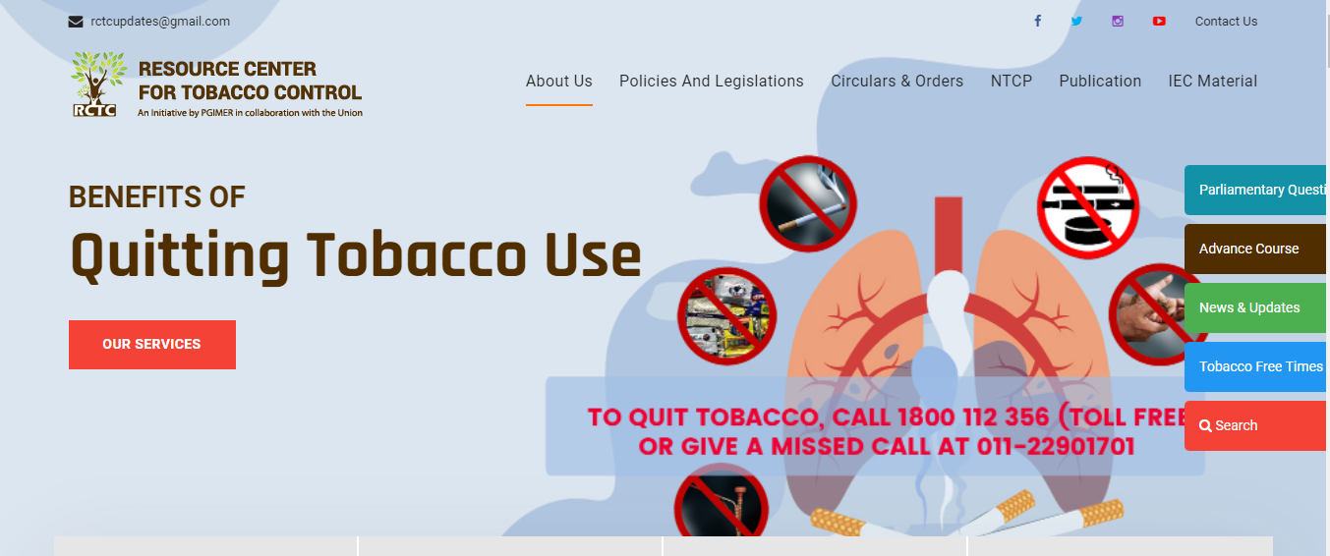

NATIONAL CONSULTATION
OF COALITION OF EXPERTS FOR FRAMEWORK DEVELOPMENT
OF TOBACCO ENDGAME HUB IN INDIA
TOBACCO ENDGAME HUB
TED^{H}

Slide 9

NATIONAL CONSULTATION
OF COALITION OF EXPERTS FOR FRAMEWORK DEVELOPMENT
OF TOBACCO ENDGAME HUB IN INDIA
GOAL of the HUB
TED^{H} envisions to achieve a Tobacco-free India by uniting global and national leaders in tobacco control and connecting them to policy makers for designing an Endgame Framework and its effective implementation.

Slide 10

NATIONAL CONSULTATION
OF COALITION OF EXPERTS FOR FRAMEWORK DEVELOPMENT
OF TOBACCO ENDGAME HUB IN INDIA
AIMS AND OBJECTIVES
Develop a repository of approaches, strategies, scientific publications and policies
Generate evidence for feasibility of various approaches
Contribute to development of communication strategies, and build capacity of diverse stakeholders
Provide technical support to government and non-government stakeholders
Notes:
Develop a repository of the tobacco endgame approaches, strategies, scientific publications and policies being implemented at the national and global level.
Generate evidence on the feasibility, effectiveness and acceptability of various endgame interventions for policy advocacy.
Contribute to development of communication strategies, build capacity in operational research and conduct leadership development programme in tobacco endgame.
Provide technical support to the governmental as well as non-governmental organizations in enhancing the skills and competencies of program managers at sub-national and level.

Slide 11

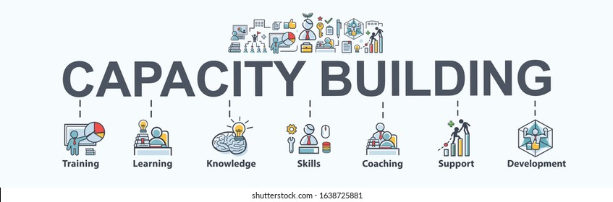


NATIONAL CONSULTATION
OF COALITION OF EXPERTS FOR FRAMEWORK DEVELOPMENT
OF TOBACCO ENDGAME HUB IN INDIA
What this Hub will provide?
DATAHOUSE

Slide 12

Let’s make this DAY a HISTORY…

